Slide 1

ALY 6060
Week 5

Slide 2
Artificial Intelligence in Decision Making
Objectives:
Describe how to apply AI to decision making using data
Define the use of AutoML to support decision making
Explain the importance of understanding data and how it can potentially drive bias in business decisioning

Slide 3
Application to Signature Assignment
Part 1: For this assignment, you will explain the requirements, rules, or recommendations that can lead to a successful implementation of embedded analytics in the context of building, reporting, and using Business Intelligence in a commercial operation. The final product should be able to serve as a “whitepaper” for professionals who are interested in, yet completely new to embedded analytics and Business Intelligence.
Be sure to address (not necessarily in this order):
Why data decisioning so important to guiding organizational leadership
The strategic planning activities that need to take place in the context of building, reporting, and using Business Intelligence in a commercial operation
Some common tools to use for Business Intelligence and how they can be used
The role of models, user interface, culture, and design in a quality system
The role of data scientist or data analyst in organizational decision making
How to use utilize an organization's data assets to drive decision making
How the fourth industrial revolution is important to data analytics and business intelligence.
How to apply BI concepts to decision making in the fourth industrial revolution
How AI can be applied to decision making using data
How to avoid bias in business decisioning
Part 2: Condense your paper into a presentation of no more than 10 slides. The presentation should be able to be used as a guide to individuals who are completely new to embedded analytics and Business Intelligence.

Slide 4
Define “Artificial Intelligence”
Write your definition in the chat

Slide 5
Some Definitions
“Artificial intelligence leverages computers and machines to mimic the problem-solving and decision-making capabilities of the human mind.” (https://www.ibm.com/cloud/learn/what-is-artificial-intelligence)
“algorithms…designed to make decisions, often using real-time data.” (https://www.brookings.edu/research/what-is-artificial-intelligence/)
“The capability of a machine to imitate intelligent human behavior.” (https://www.forbes.com/sites/bernardmarr/2018/02/14/the-key-definitions-of-artificial-intelligence-ai-that-explain-its-importance/?sh=5455020d4f5d)

Slide 6
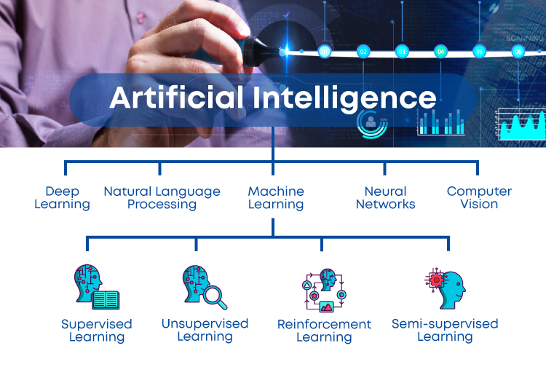
What Makes AI Work?
Notes:
Reinforcement learning is the training of machine learning models to make a sequence of decisions. The agent learns to achieve a goal in an uncertain, potentially complex environment. In reinforcement learning, an artificial intelligence faces a game-like situation. ... Its goal is to maximize the total reward.
Semi-supervised learning is an approach to machine learning that combines a small amount of labeled data with a large amount of unlabeled data during training. Semi-supervised learning falls between unsupervised learning (with no labeled training data) and supervised learning (with only labeled training data).

Slide 7
ML and AutoML
Machine learning is a field of artificial intelligence that uses statistical techniques to give computer systems the ability to "learn" (e.g., progressively improve performance on a specific task) from data, without being explicitly programmed.
AutoML automates common machine learning steps that are often repetitive and involve a good amount of trial and error on the path to producing quality machine learning models.
AutoML means automated machine learning. It gives enterprises the power to train and deploy thousands of models to fit the needs of various customers and industries through an automated approach.
The process of automating the end-to-end process of applying machine learning to real-world problems.

Slide 8
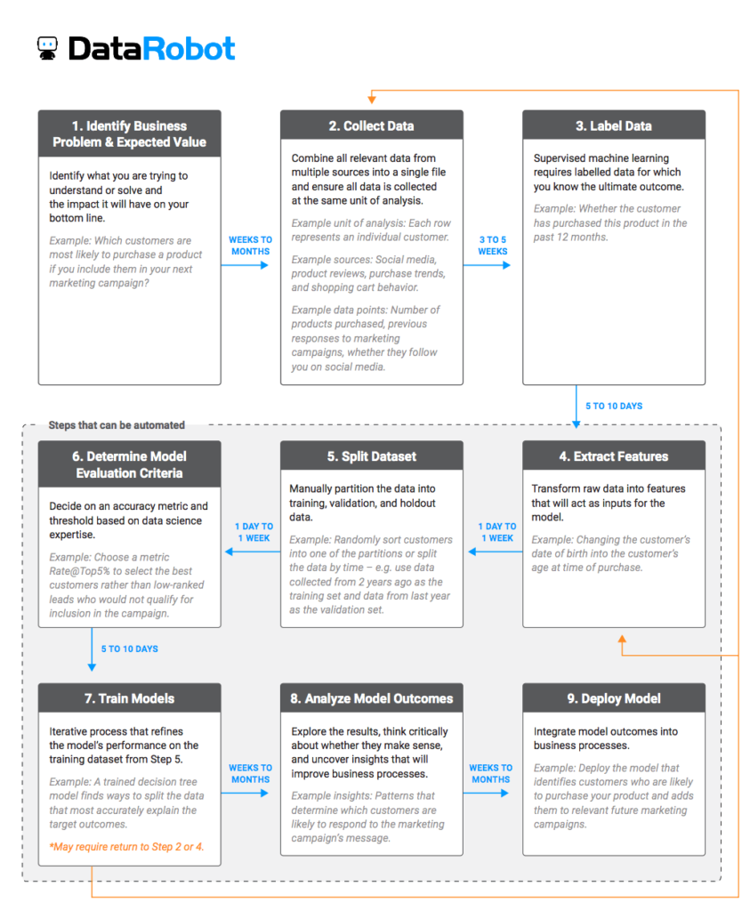
The Traditional Process to Develop a Model
The only automated task is Training
(https://www.datarobot.com/wiki/automated-machine-learning/)

Slide 9
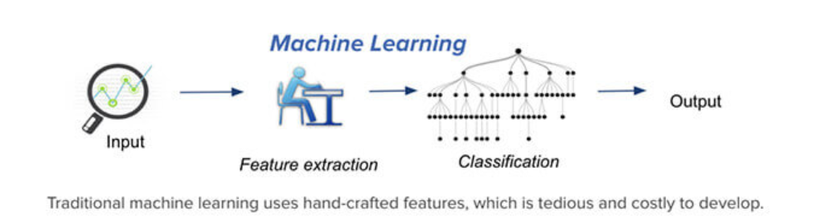
https://www.merkleinc.com/blog/dispelling-myths-deep-learning-vs-machine-learning

Slide 10
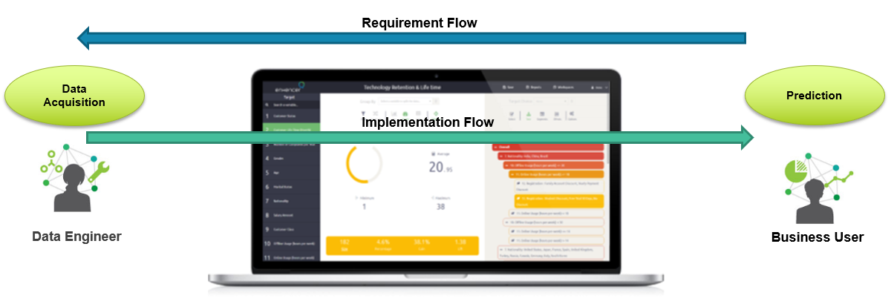
AutoML
“AutoML focuses on two aspects – Data acquisition and prediction. All the steps that take place in between these two phases will be abstracted by the AutoML platform. Essentially, users bring their own dataset, identify the labels, and push a button to generate a thoroughly trained and optimized model that's ready to predict.”
(https://www.forbes.com/sites/janakirammsv/2018/04/15/why-automl-is-set-to-become-the-future-of-artificial-intelligence/?sh=407ff059780a)

Slide 11
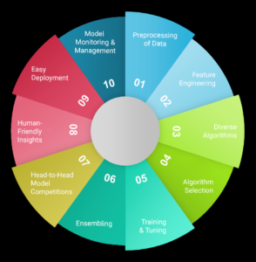
The AutoML process after uploading a dataset and choosing the target variable for the business problem (https://www.datarobot.com/wiki/automated-machine-learning/)

Slide 12
AI and Decision Making
Strategic decisions are extremely valuable and important, yet infrequent or “low volume,” decisions that guide the direction of an organization. Not repeatable, not candidates for AI.
Tactical decisions are business decisions that are made repeatedly during the course of business and involve data and analysis by officers, executives, and other personnel in management and knowledge positions (Taylor, 2012)
Examples of tactical decisions include (but are not limited to) deciding on: staffing levels to implement, discounting, sales and marketing strategies to use, allocation of work assignments to particular groups and people, and which purchases to make (Latham, n.d.).
Repeatable, candidates for AI.
Operational decisions are daily business decisions that happen every time a business process or transaction occurs.
For example, an operational decision is made every time an order is placed, a customer makes a purchase, a credit card transaction is approved, an insurance claim is made, etc.
Highly repeatable, ideal candidates for AI.
Micro decisions are a special kind of operational decision that focuses on one customer at a time and aims to personalize an interaction with that individual.
Highly repeatable, high volume—ideal candidate for AI.

Slide 13
Business Decisions Suitable for AI
Repeatable
Nontrivial
Defined and measurable business impacts
Suitable for automation (Taylor, 2012)
Notes:
Repeatable-happen often, high volume
nontrivial: complex, need to analyze large amounts of data, and have a large number of possible outcomes, none of which is necessarily perfect. A

Slide 14
7 Business Decision Types Suited to Automation
1. Determining customer eligibility for A service or product
2. Validating transactions or customers
3. Calculating prices for products and specific customers at a specific point in time
4. Assessing the risk inherent in a particular customer or transaction
5. Identifying fraud or abuse
6. Identifying opportunities to cross-sell or up-sell to specific customers (Taylor, 2012)

Slide 15
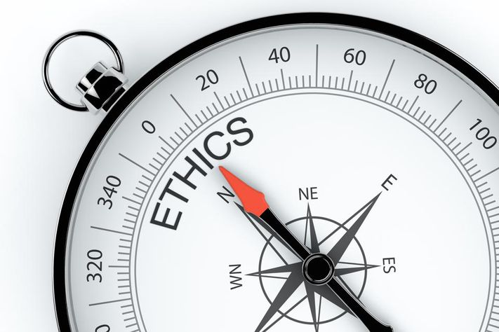
What ethical issues are associated with the use of AI?

Slide 16
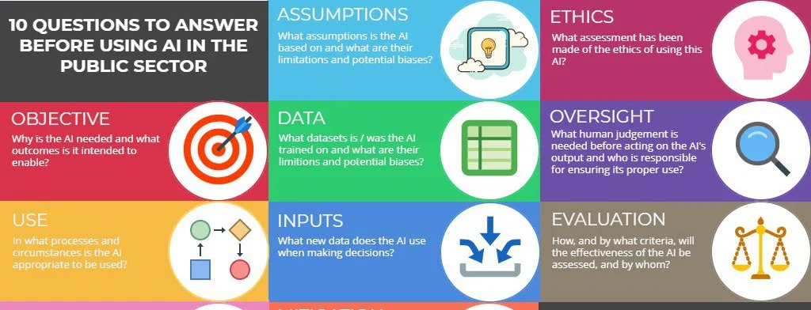
AI: Ethical Issues
https://cdofromhel.fi/2019/06/12/the-ethics-of-using-artificial-intelligence-in-city-services/

Slide 17
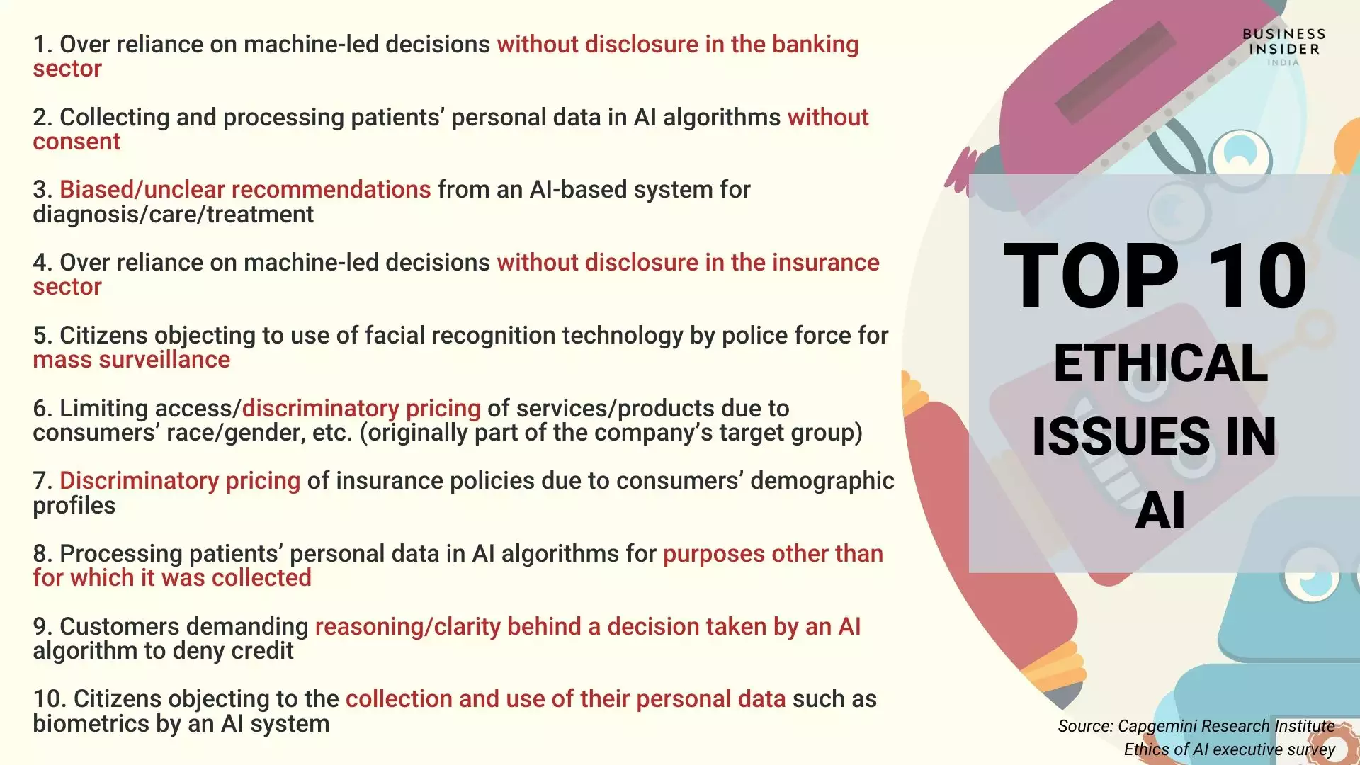
https://www.businessinsider.in/tech/news/artificial-intelligence-in-2020-needs-to-be-about-ethics-in-india/articleshow/72935214.cms

Slide 18
Activity
Review the reading, “Healthcare, Artificial Intelligence, Data and Ethics – a 2030 Vision”
Address in groups:
What strategies do the authors recommend to ethically and responsibly develop and deploy AI?
Share with class

Slide 19

Case Study
COMPAS (Correctional Offender Management Profiling for Alternative Sanctions), a case management and decision support tool developed and owned by Northpointe (now Equivant) used by U.S. courts to assess the likelihood of a defendant becoming a recidivist.

Slide 20
Read
Read “When an Algorithm Helps Send You to Prison” (NY Times, 10/26/17)
https://www.nytimes.com/2017/10/26/opinion/algorithm-compas-sentencing-bias.html
Reflect in groups:
What ethical issues related are evident in this case study?
Imagine you are Timothy Brennan, Northpointe founder and CEO, and you wanted to make sure you were doing all you could to address any possibility of your COMPAS AI software exhibiting and amplifying biases within the US criminal justice system/
How would you go about organizing a Northpoint response to evaluate and address the fairness of COMPAS software while still protecting customer and investor confidence, as well as the intellectual property associated with your advanced AI product?
Share with class

Slide 21
Week 6
Present your Signature Assignment in class
Other end-of-course activities

